Slide 1

The Judge Motor Line
Reliable, high-performance, cost-effective motor

Slide 2
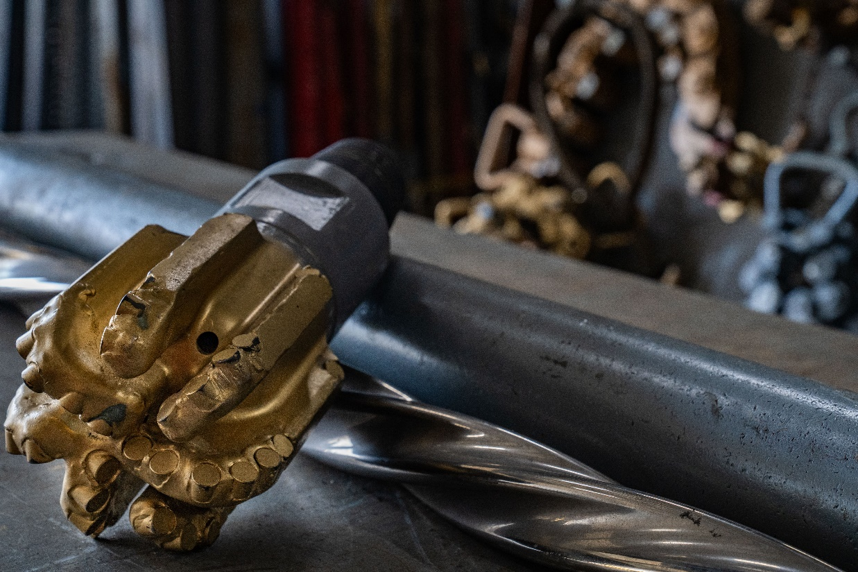
Judge Motors
Introduction to tool
Features
Benefits
Specs
Case Study
Contact Information
WOS Overview & Locations

Slide 3
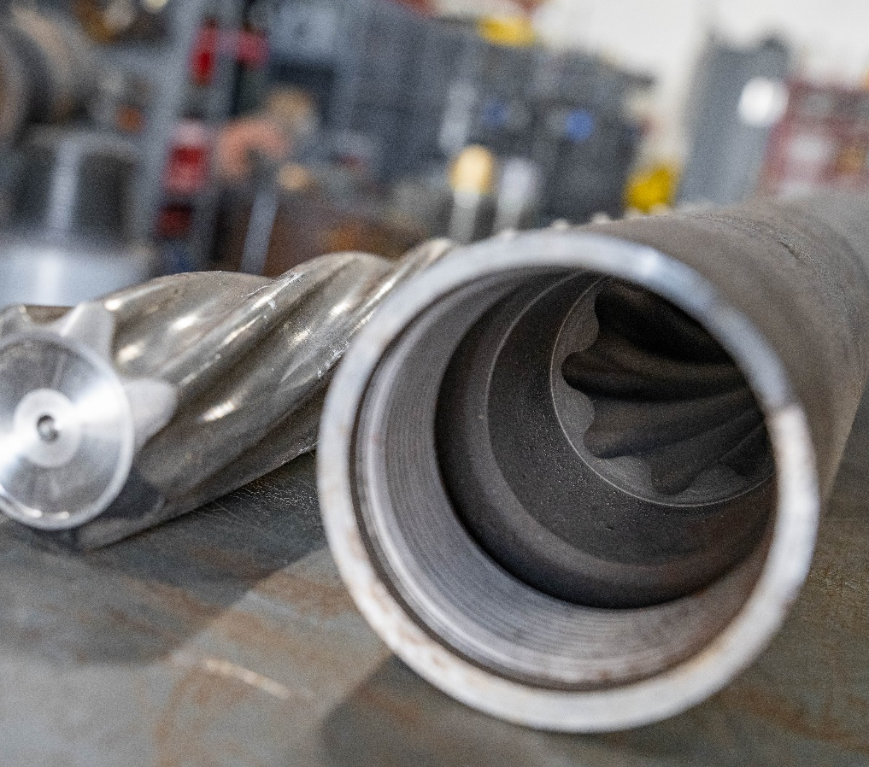


Judge Motor Overview
The WOS engineered and manufactured Judge Series downhole motors are the product of years of data and development from the record breaking on the WOS POWR Motors line. The simplicity and durability of our motors provides us with a consistently reliable, high-performance, cost-effective motor.
For our customers, this means less non-productive time and fast, clean mill outs. WOS motors hold numerous records for time in hole and plug count drilled out in a single run.
Workover Solutions proprietary motor design are wholly manufactured, serviced and fully supported in-house by WOS engineers and technicians.
3

Slide 4

Next Gen 3-1/4” Motor Fleet – “The Judge”
3-1/4” Motor Line to replace legacy 3-1/8” POWR motors in WOS fleet
Upgrades include
Increased torsional yield
Better flow areas around transmission and diverter
Combined transmission housing and upper bearing housing into one part to eliminate a thread connection below stator
Upper Radial Bearing is a separate bushing (also done on the 238 motor). Wear component is now a separate piece.
Increased torque capacity through drive train
3-1/4” Specs
Max OD: 3.250 in
Overall Tool Length: 177 in
Torsional Yield: 4,100 Ft-LBS
Top Connection: 2-3/8” REG Box
Bottom connection: 2-3/8” REG Box
3-1/8” Specs
Max OD: 3.13” in
Overall Tool Length: 155 in
Torsional Yield: 2,800 Ft-LBS
Top Connection: 2-3/8” REG Box
Bottom connection: 2-3/8” REG Box

Slide 5
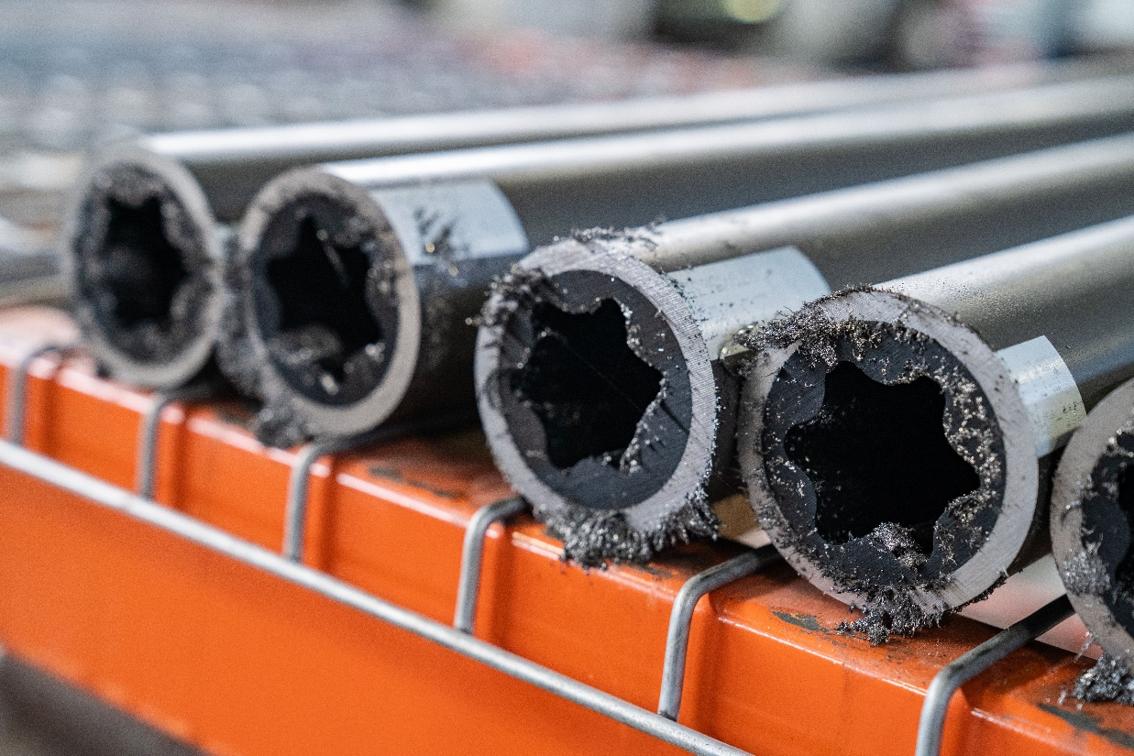
Features
High flow 8bpm options available
Increased torsional yield
Increased torque capacity through drive train
Integrated rotor catch
Better flow areas around transmission and diverter compared to legacy POWR Motors
Flexible subs built into tools to add in bending
Hard banding top sub to reduce OD wear
5

Slide 6
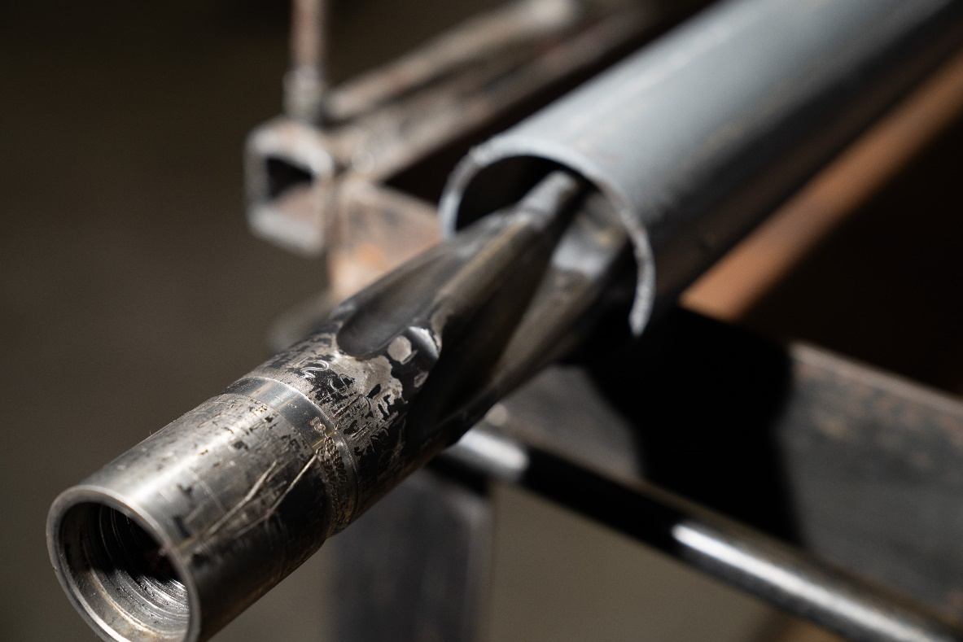
Benefits
Combined transmission housing and upper bearing housing eliminating a thread connection below stator
Increased torsional yield allows for more aggressive drilling and agitator selection
One run long lateral and high plug count wells reduce the need for trips
All motors dyno tested before heading to location ensuring stated motor performance
Developed based on POWR Motors that own record-breaking high plug count and long lateral applications
6

Slide 7
Judge Motor Specs
Accessories
WOS High Flow Check Valves
WOS AV Sub
WOS Flex Sub
WOS PulverizR Bits
BitSavR
WOS EaZy Drill
7

Slide 8
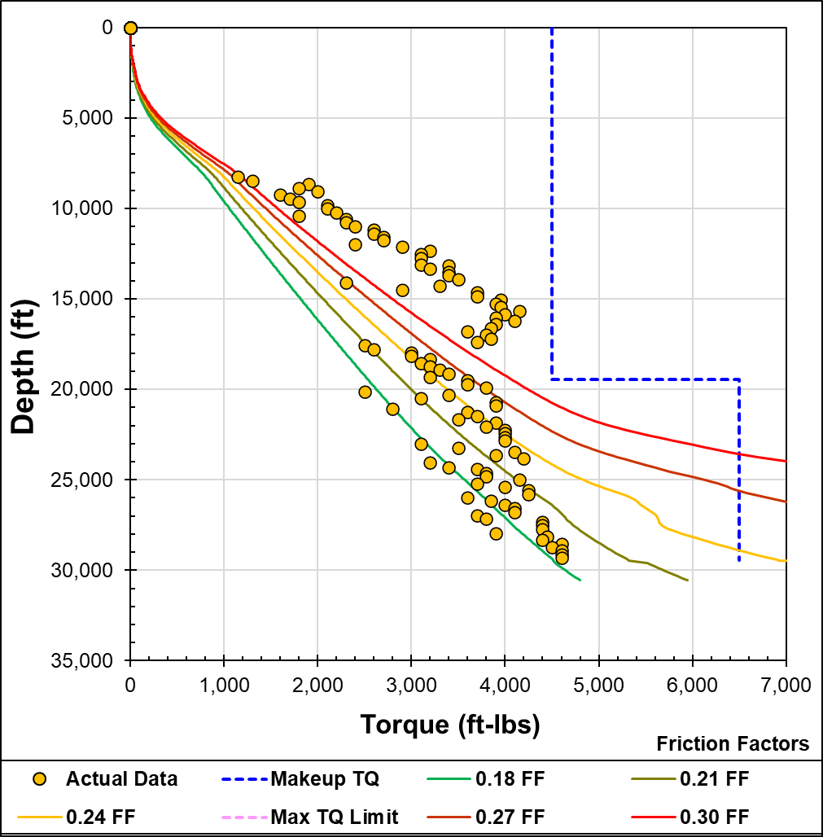
Case Study – Judge Motor
Well C, 3-1/4” Motor
Marcellus Operator with deep well drillout operation adopts new WOS 3-1/4” motor design in 6-well pad
Pre-well modeling projected difficulty reaching TD on most wells
Split workstring of 2-7/8” 7.9 lb/ft x 2-7/8” 9.5 lb/ft TTWS tubing utilized for optimum reach
Production Casing: 5-1/2” 23 lb/ft
Plug Type: Nine Scorpion CFP, Nine Stinger DFP (last 10 plugs)
WOS 3-1/8” BHA with POWR Motor, BitSAVR, Pioneer PDC
3-1/8” POWR Motor vs New 3-1/4” Motor
Results
On Well A, 3-1/4” motor chosen for shortest well on pad, drilled out all 37 plugs successfully to 21,500’ TD.
On Well B, 3-1/8” Motor was tripped at plug 47 for tight spot. 3-1/4” motor chosen to drill out 71 remaining plugs to 30,445’ TD.
On Well C, 3-1/4” Motor drilled out 81 plugs successfully to 29,315’ TD.
Excluding Well B (partial run), 3-1/4” Motor had quicker drill times, quicker wash times, and more efficient Plugs/Hr performance with no incidents
0.18 FF at TD
Motor Size | Wells Count | Avg MD Reached (ft) | Plugs Tagged | Avg Mill Time per plug (min) | Avg Wash Time per plug (min) | Avg Total 'No Tags' | Avg Plug Spacing (ft) | Open to Close Time (hrs) | KP to TD Time (hrs) | Open to Close Hrs /1000ft Lateral | Avg Plugs Washed per Hr
3-1/8” | D E F | 31,245 | 107 | 15.99 | 67.34 | 12 | 197 | 186.8 | 150.5 | 8.01 | 0.80
3-1/4” | A C | 27,075 | 63 | 9.65 | 53.06 | 17 | 278 | 98.1 | 67.3 | 7.98 | 1.04

Slide 9
Contact Information
To secure the highest quality of tools engineered, manufactured and tested in the USA contact your local WOS representative or contacts below
Main phone - 346-774-4433
Email - sales@wos.com

Slide 10
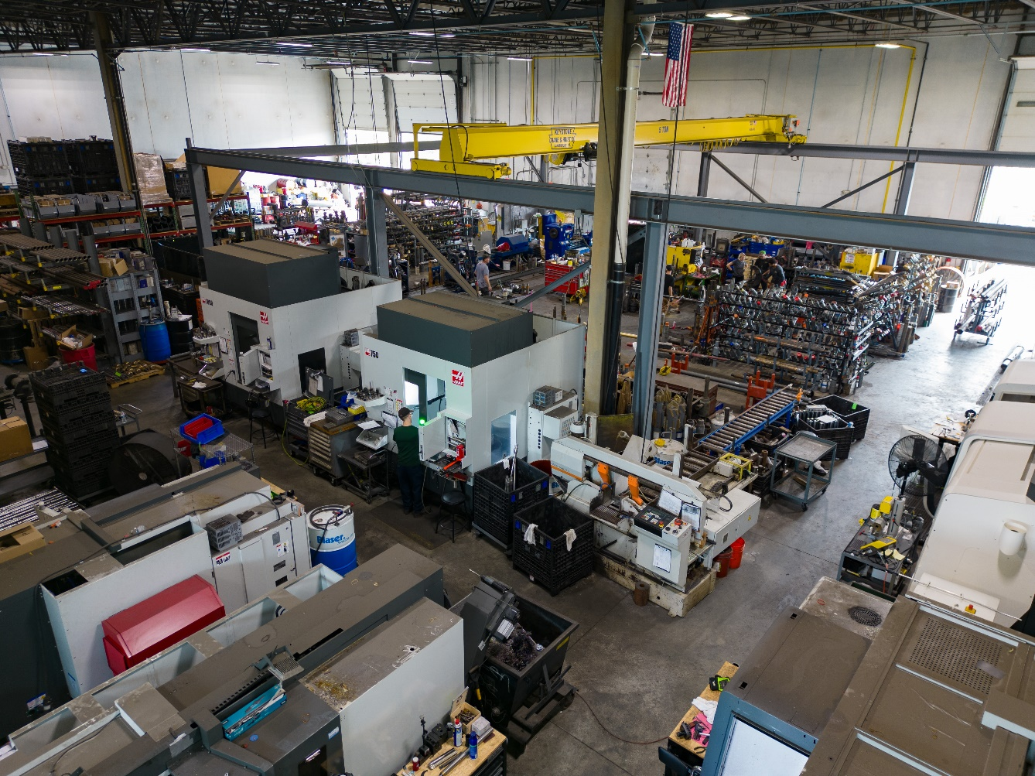

WOS Company Overview
Started Operations in Q3 2015
Fully Supported Downhole Tool Division
Design & Engineering
Machining & Fabrication
Field Operations
Rebuild & Redress
Evaluate Performance
Wireline
6 trucks in the Northeast
Started operations in July 2018
Operational Coverage
Pennsylvania, Ohio, West Virginia, and New York
Texas, New Mexico
North Dakota, Wyoming, Utah
Louisiana
KSA Operations started 2025
Dammam, KSA
GOtech sponsored
Argentina Operations started 2025

Slide 11
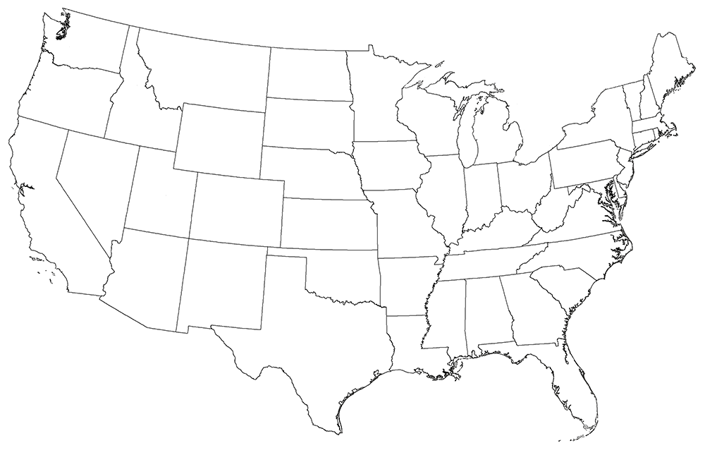

WOS Locations
Mansfield, PA
Casper, WY
Hazen, ND
Wooster, OH
WOS HQ
Imperial, PA
WOSi HQ
Dammam, KSA
Kilgore, TX
Odessa, TX
R&D - Houston, TX

